Slide 1

T & T Predictive Analytics Presents: Violent Crime Predictor
Temidayo Akinsanya
Oluwatobi Akinsanya

Slide 2


T & T Predictive Analytics Presents: Violent Crime Predictor
Temidayo Akinsanya
Oluwatobi Akinsanya

Slide 3

Background
Time to Predict the Future!
Our website has been to design to create a space where any one can gain insight into how violent their current or future neighbors will be based on a variety of factors.
Use cases: Police work, Real Estate, Family planning, business growth, and more.

Slide 4

Approach
Extraction
Census 2018
Previous project code
Data Transformation
Data cleaning
Model
Model Training
67% – Train, 33% - Predict
Web
Model Tuning
HTML,
CSS, JavaScript
Heroku SQL Database
Choosing attributes
Jupyter Notebooks
XG Boost Machine Learning Algorithm
FBI 2018

Slide 5

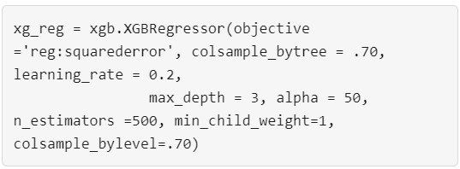
Model Characteristics
Education
(3)
Marital and Gender Status (3)
Race and Employment (4)
Violent Crime Rate
Data Available
33 total features
10 features used
Model Performance
RMSE: 176.041975 ; R²: 0.9102549
Root Mean Square Error (RMSE): is the standard deviation of the residuals (prediction errors). Residuals are a measure of how far from the regression line data points are.
R-squared (R²): is a statistical measure of how close the data are to the fitted regression line
XG Boost
Model Tuning

Slide 6
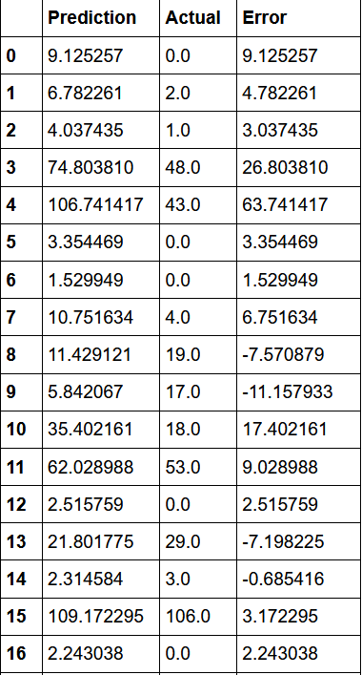
Violent Crime Prediction vs Actual

Slide 7

Machine Learning Demo

Slide 8
Q&A

